Slide 1

Patient Wayfinding Overview
by Robert Tabb, Director of Healthcare

Slide 2


Challenges Hospitals Face During the Patient Journey
Effective patient communication and access to information is the key to quality care.
WAIT TIMES
CANCELLATIONS
INFORMATION
ICD-10
EHR/EMR
AFFORDABLE CARE ACT
HIPAA
PATIENT SATISFACTION
POPULATION
MALPRACTICE
NO-SHOWS
SCHEDULING

Slide 3
Patient Satisfaction Drives Hospital Profitability
When hospitals are ranked by profitability, the most profitable hospitals
have the highest Press Ganey patient satisfaction scores.
With over
$1 Billion in Medicaid funding tied to the HCAHPS survey, patient satisfaction
is more important
than ever.

Slide 4
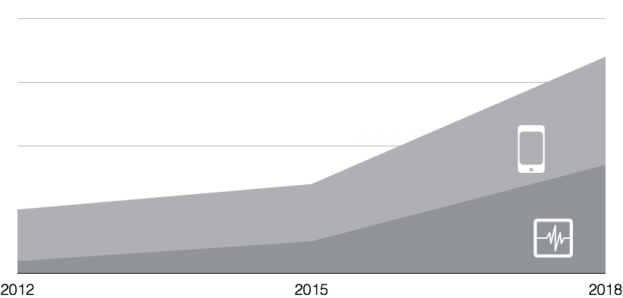
Why Use Mobile to Improve Patient Experience?
In 2015, two-thirds of the population is using a SmartPhone and 1 in 3 people has a health-related app.
That the average smartphone owner:
Unlocks their phone to interact with it more than 100 times per day
Accesses 25 different apps in the course of a month
Spends 44 hours per month interacting with their phone
SMARTPHONES
SMARTPHONES WITH HEALTH-RELATED APP
All this access generates a Pavlovian response — the consumer learns that whatever the question is, the answer is on the phone.
Notes:
Multiple studies now show that consumers unlock their phones to interact with them more than 100 times per day. Data that Forrester collects from customers’ mobile phones shows that the average smartphone owner accesses 25 different apps in the course of a month and spends 44 hours per month interacting with their phone. All this access generates a Pavlovian response — the consumer learns that whatever the question is, the answer is on the phone.
By the end of 2014, three out of four US mobile subscribers, or 66% of the population, will have a smartphone
From Forrester’s mobile mindshift

Slide 5
Wayfinding Impacts Patients, Staff and Revenue
OF FIRST TIME VISITORS REPORT CONFUSION
30%
OF REPEAT VISITORS ARE CONFUSED
15%
OF STAFF MEMBERS CAN’T FIND THEIR DESTINATION
28%
OF HOSPITALS REPORTED IDLE STAFF WHEN PATIENTS ARE LATE
40%

Slide 6
GPS, WiFi and BLE Wayfinding

Slide 7
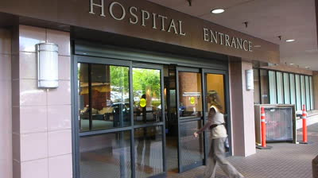
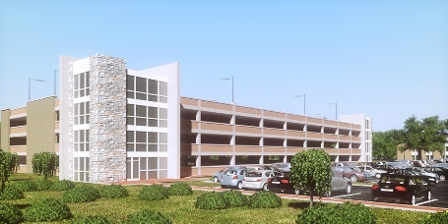


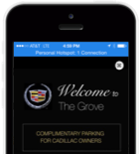
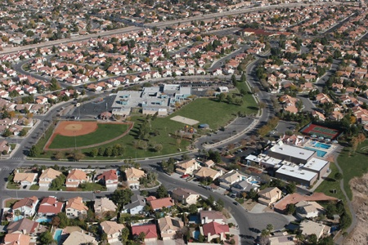

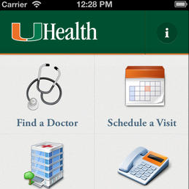
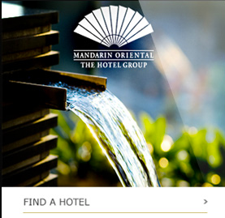
Guide the Patient Journey with Phunware
Through the front door
To the parking lot
Across departments
From the neighborhood
All the way to the office
7

Slide 8
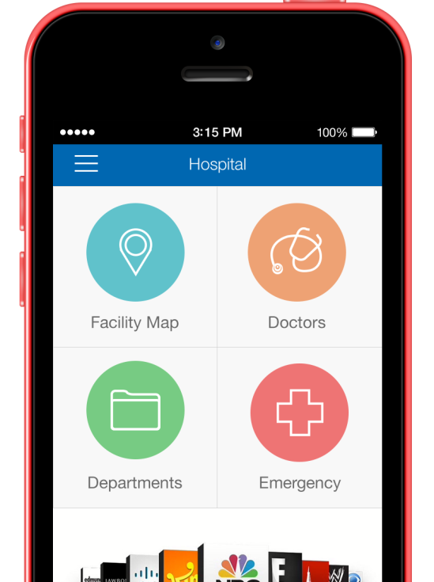
Guide the Patient Journey with Phunware
5
Through the front door
To the parking lot
Across departments
From the neighborhood
All the way to the office
Notes:
Turn by turn with visual representation
Talk about static vs dynamic wayfinding
Wayfinding mapping information cached in the phone – blue dot with beacons – still get the text directions

Slide 10
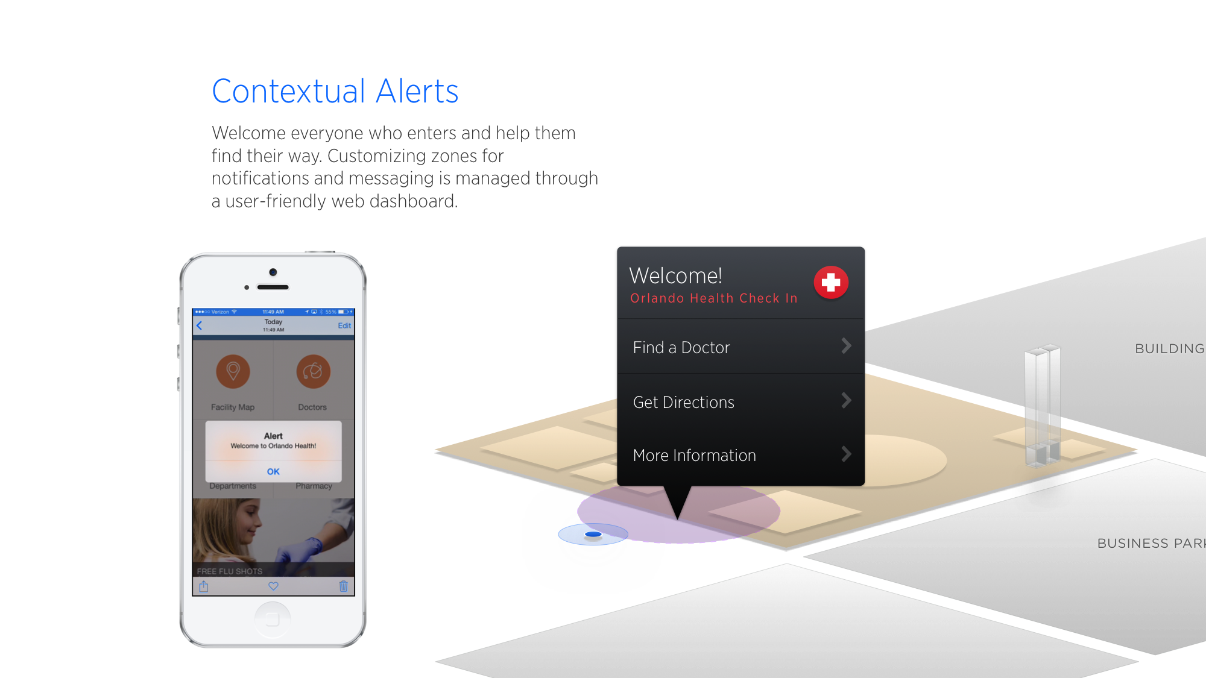
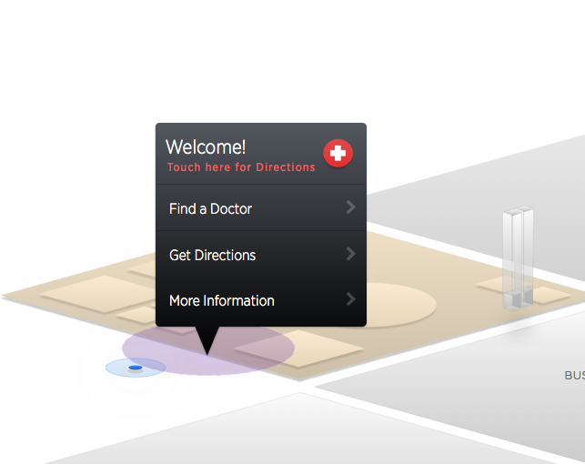
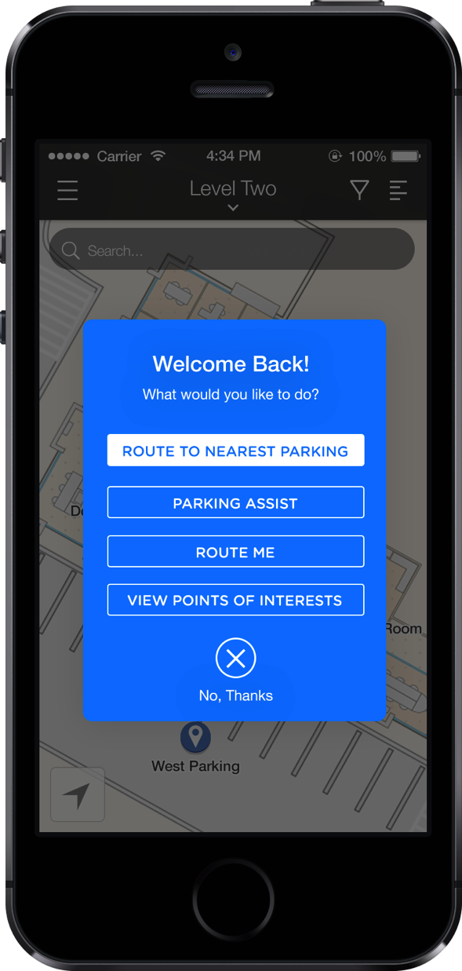
Notes:
Options – and start a check-in process
Can ask which ever questions you want upon arrival

Slide 11
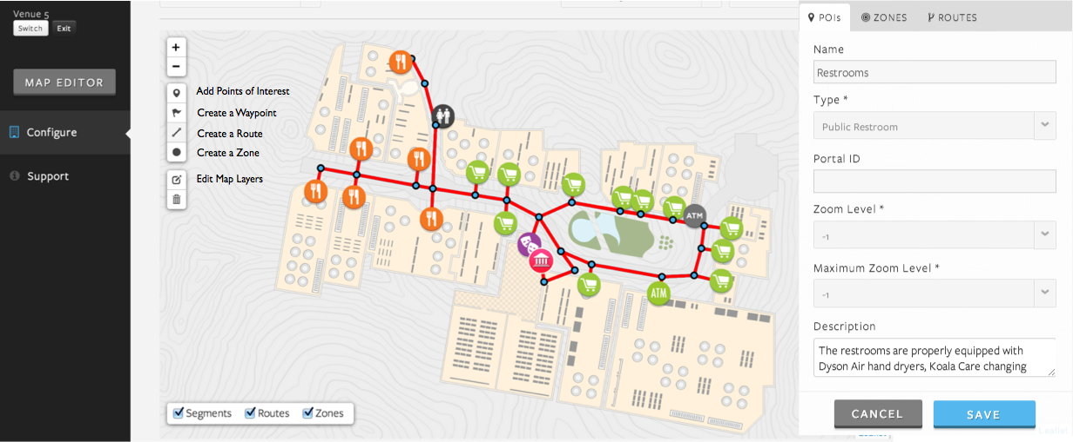
User Friendly Map Editor Portal
Hospital Administrators can update the facility map to reflect changes like hallway closures and staff only areas without relying on developer resources.
Notes:
Mapping editor
Control which routes are patient accessible
Able to grow and scale with the campus

Slide 12
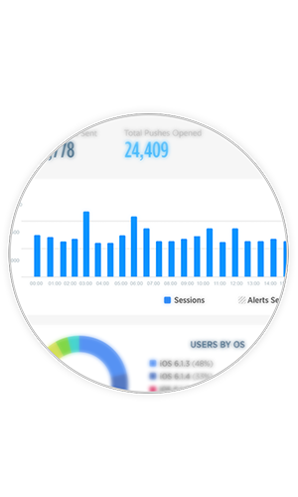
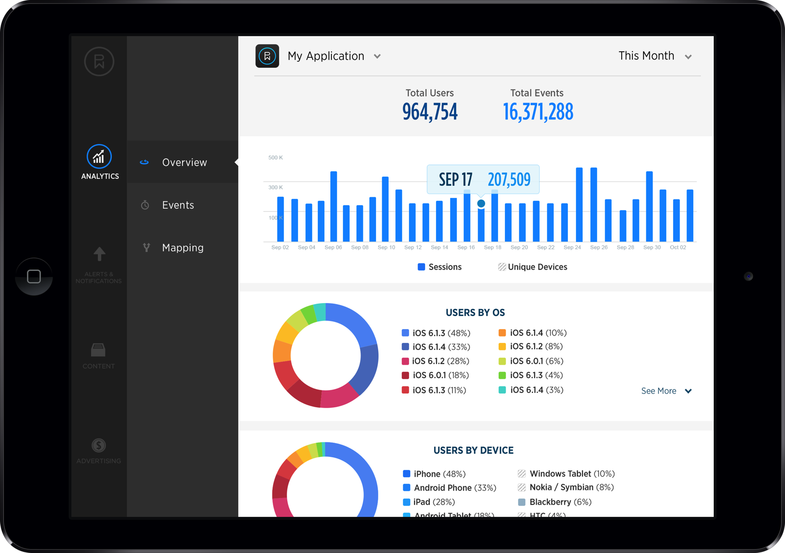
Benefits for Hospital Administrators
Manage Patient Outreach
  Event Promotion
  Alerts
  Push Notifications
  Curated Content
Improve and Streamline Wayfinding
  Easily integrate with existing wayfinding strategies
      Campus maps can be easily updated in the cloud to display facility closures, staff only areas, Points of Interest and more
Make informed decisions with advanced analytics
12 | phunware.com
Notes:
Alerts – productive waiting for patient engagement
Curated content – can segment users from the beginning and send relevant information
# of patients using the application
Ways in which they are using it
Which departments are the hardest to find – make decisions for digital signage
Geofencing – which patients are going to nearby clinics – 3rd party or competitor

Slide 13
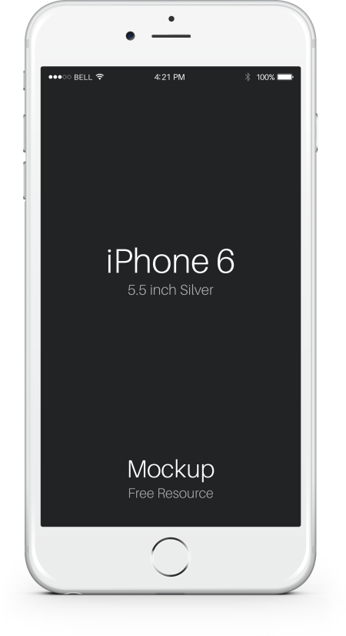
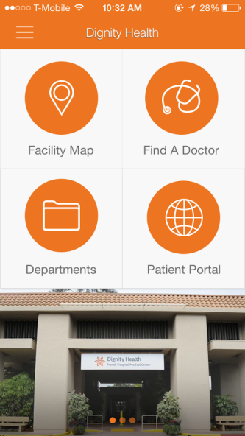
Dignity Health: French Hospital Medical Center
“The addition of the FrenchWay app here at French Hospital provides another resource with which we can continue to improve our patient and visitor experience. This app will not only make navigating the hospital easier, it will also ensure our patients and visitors have access to the latest French Hospital news, information on services, and even the newest promotions in our gift shop.”
Instant directions from a
patient’s home to the hospital
Find one of our
expert Physicians
Navigational tools including
an indoor GPS to guide
patients within our building
Connection to the Patient
Portal to check appointments
and medical history
Information on French
Hospital physicians and
department services
Other app
features include:
Up-to-date news feed
Event and
promotion offers
Construction and modernization updates
-Alan Iftiniuk, President / CEO
Notes:
Built application from the ground up, branded to dignity health – looks like a proprietary app
Multi-venue/hospital solution

Slide 14

THE SOFTWARE OF THINGS™
CORPORATE HEADQUARTERS
7800 Shoal Creek Blvd.
Suite 230-S
Austin, Texas 78757
(855) 521-8485 - Office
info@phunware.com
www.phunware.com

